Slide 1
Types of Financial statement
UNIT -6

Slide 2
Financial Statement
Every business wants to know the result of its activities of a particular period which is generally 1 year & what is its financial position on a particular date which is at the end of this period
Financial statements are the statements that are prepared at the end of accounting period, which is generally one year. These include income statement i.e. trading & profit & loss account & position statement i.e. balance sheet.

Slide 3
Types of financial statemnt
Profit loss statement
Balance Sheet
Profit loss Statement
Profit loss statement in a summary from the incomes earned, expenses incurred and net profit made by a business unit during a period of time, usually a year.
Profit= Income - Expenses

Slide 4
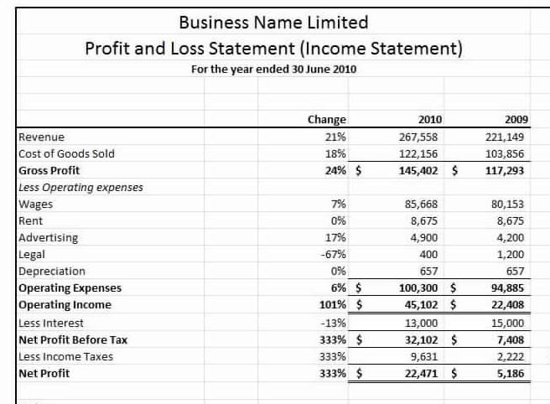

Slide 5
Balance Sheet
The balance sheet displays the company’s total assets, and how these assets are financed, through either debt or equity. It can also be referred to as a statement of net worth, or a statement of financial position. The balance sheet is based on the fundamental equation: Assets = Liabilities + Equity.

Slide 6
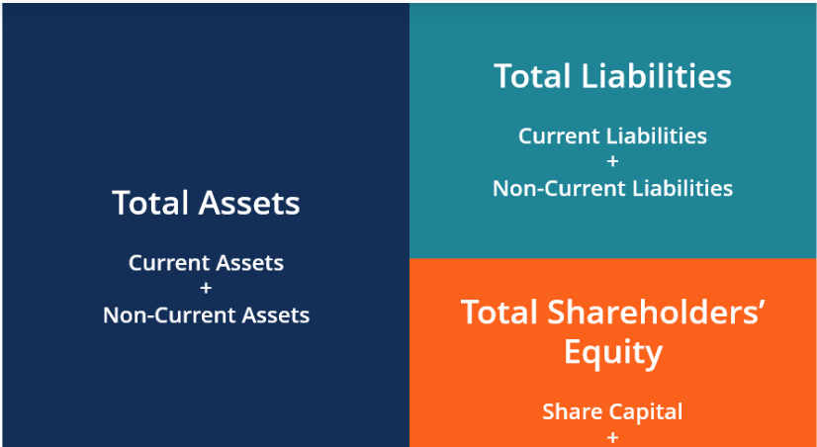

Slide 7
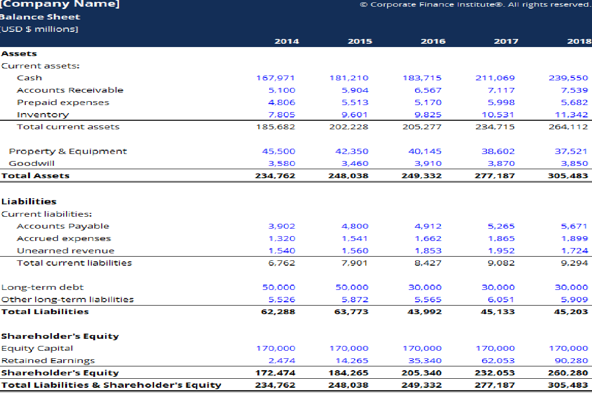

Slide 8
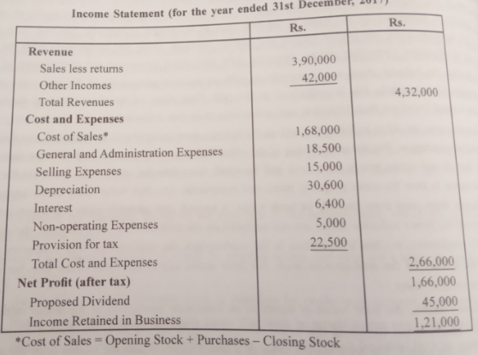
Income statement

Slide 9
Numerical on income statement
Profit & Loss Statement for Company XYZ, Inc. for the year ended December 31, 2008 Total Revenue $100,000 Cost of Goods Sold ------ Gross Profit 80000 Operating Expenses Salaries $10,000 Rent $10,000 Utilities $ 5,000 Depreciation $ 5,000 Total Operating Expenses ---------- Operating Profit (EBIT) ---------- Interest Expense ($ 10,000) Income before taxes (EBT) ---------- Taxes ($ 10,000) Net Income -------------

Slide 10
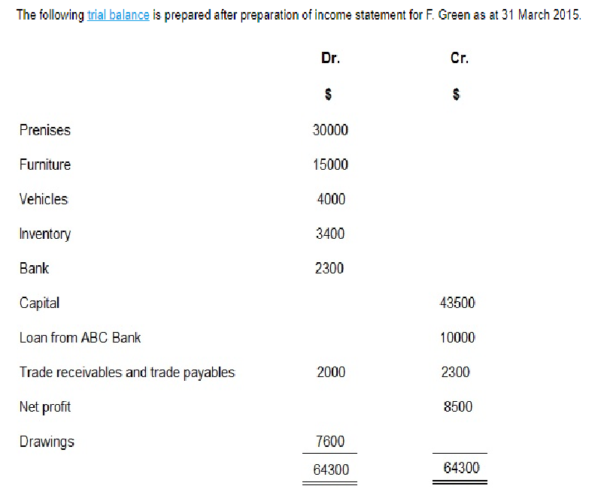
Example 1: Preparation of Balance Sheet – Horizontal and Vertical Style:

Slide 11
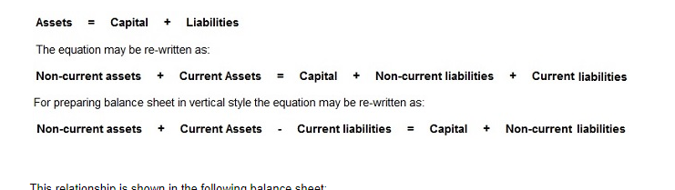

Slide 12
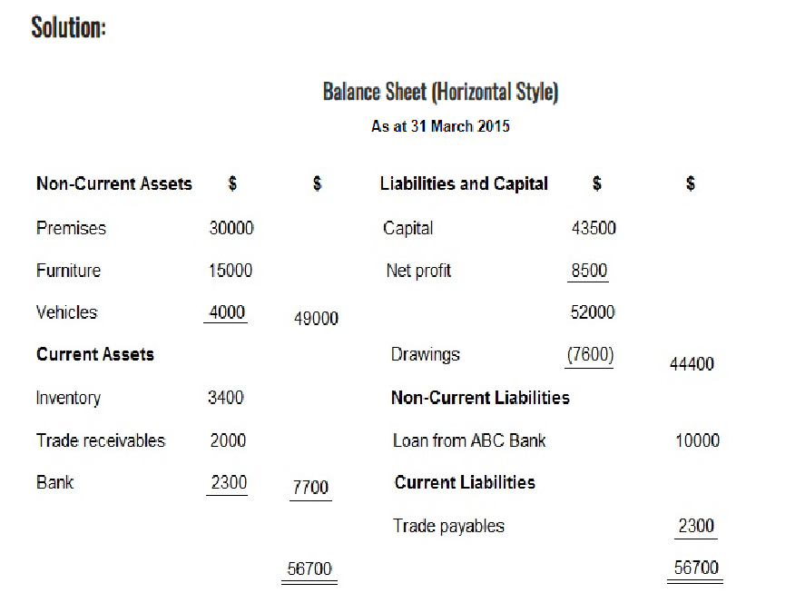

Slide 13
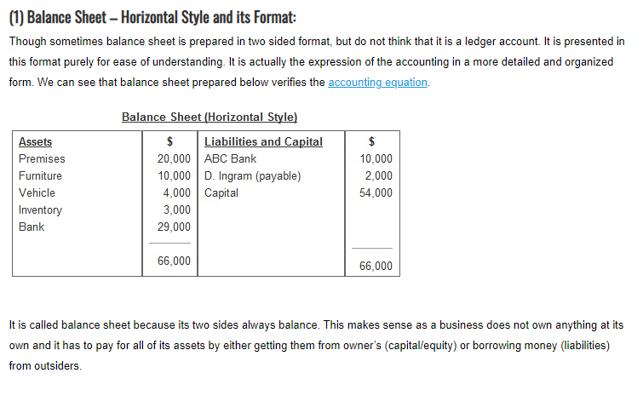

Slide 14
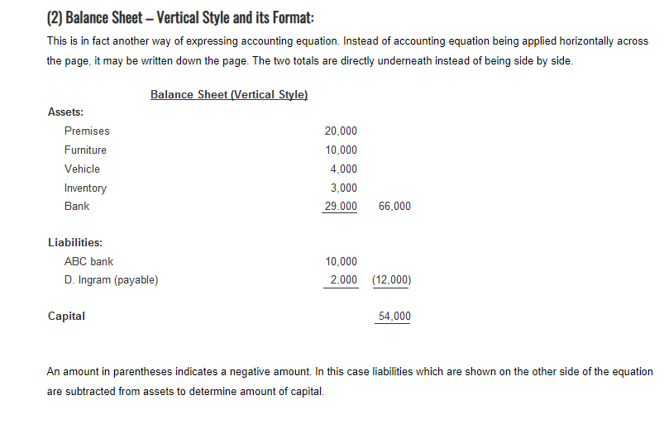

Slide 15
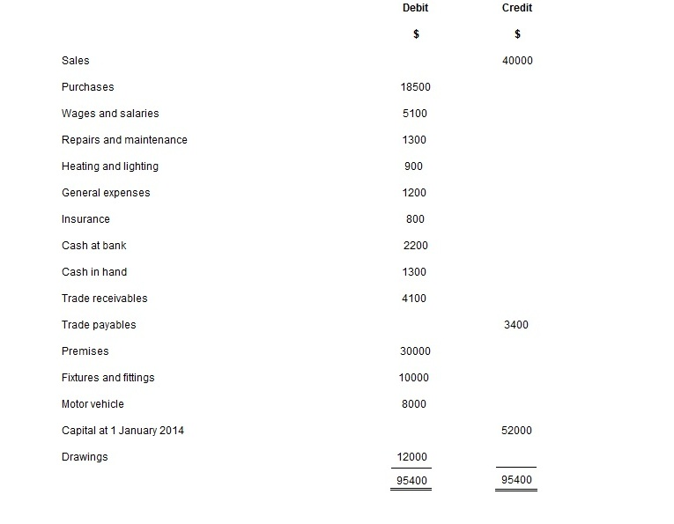
Prepare an income statemnt

Slide 16
The following additional information is available:
Inventory at 31 December 2014 was valued at $4500.
Required:
(a) Prepare income statement for the year ended 31 December 2014.

Slide 17
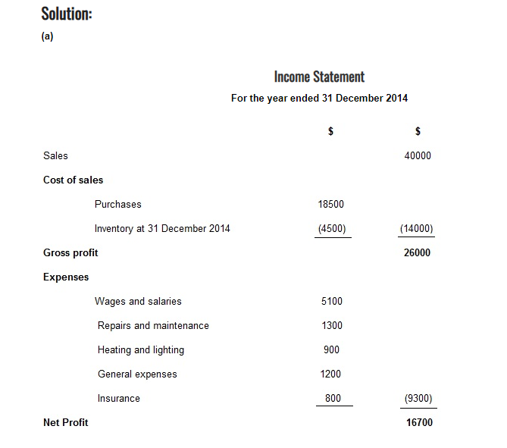

Slide 18
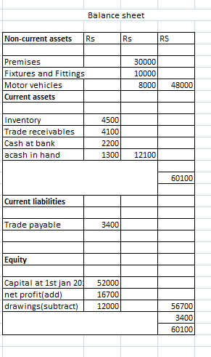

Slide 19
ASSETS
The first subcategory lists the current assets in order of their liquidity. Here’s a list of the most common accounts in the current section:
Current
Cash
Accounts Receivable
Prepaid Expenses
Inventory
Due from Affiliates

Slide 20
The second subcategory lists the long-term assets. This section is slightly different than the current section because many long-term assets are depreciated over time. Thus, the assets are typically listed with a total accumulated depreciation amount subtracted from them. Here’s a list of the most common long-term accounts in this section:
Long-term
Equipment
Leasehold Improvements
Buildings
Vehicles
Long-term Notes Receivable

Slide 21
Many times there will be a third subcategory for investments, intangible assets, and or property that doesn’t fit into the first two. Here are some examples of these balance sheet items:
Other
Investments
Goodwill
Trademarks
Mineral Rights

Slide 22
Liabilities Section
Liabilities are also reported in multiple subcategories. There are typically two or three different liability subcategories in the liabilities section: current, long-term, and owner debt.
The current liabilities section is always reported first and includes debt and other obligations that will become due in the current period. This usually includes trade debt and short-term loans, but it can also include the portion of long-term loans that are due in the current period. The current debts are always listed by due dates starting with accounts payable. Here’s a list of the most common current liabilities in order of how they appear:
Current Liabilities
Accounts Payable
Accrued Expenses
Unearned Revenue
Lines of Credit
Current Portion of Long-term Debt

Slide 23
The second liabilities section lists the obligations that will become due in more than one year. Often times all of the long-term debt is simply grouped into one general listing, but it can be listed in detail. Here are some examples:
Long-term Liabilities
Mortgage Payable
Notes Payable
Loans Payable

Slide 24
Equity Section
Unlike the asset and liability sections, the equity section changes depending on the type of entity. For example, corporations list the common stock, preferred stock, retained earnings, and treasury stock. Partnerships list the members’ capital and sole proprietorships list the owner’s capital.
Like all financial statements, the balance sheet has a heading that display’s the company name, title of the statement and the time period of the report. For example, an annual income statement issued by Paul’s Guitar Shop, Inc. would have the following heading:
Paul’s Guitar Shop, Inc.
Balance Sheet
December 31, 2015

Slide 25
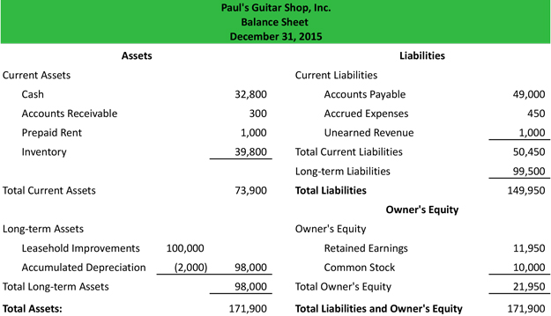

Slide 26
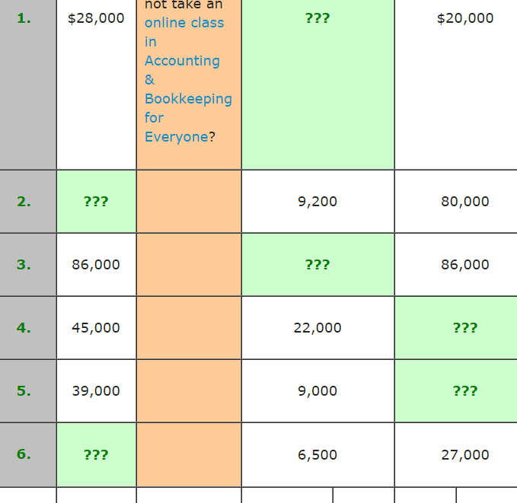
Assets = liabities + Equity

Slide 27
1.8000
2. 89200
3. 0
4. 23000
5.30000
6.33500

Slide 28
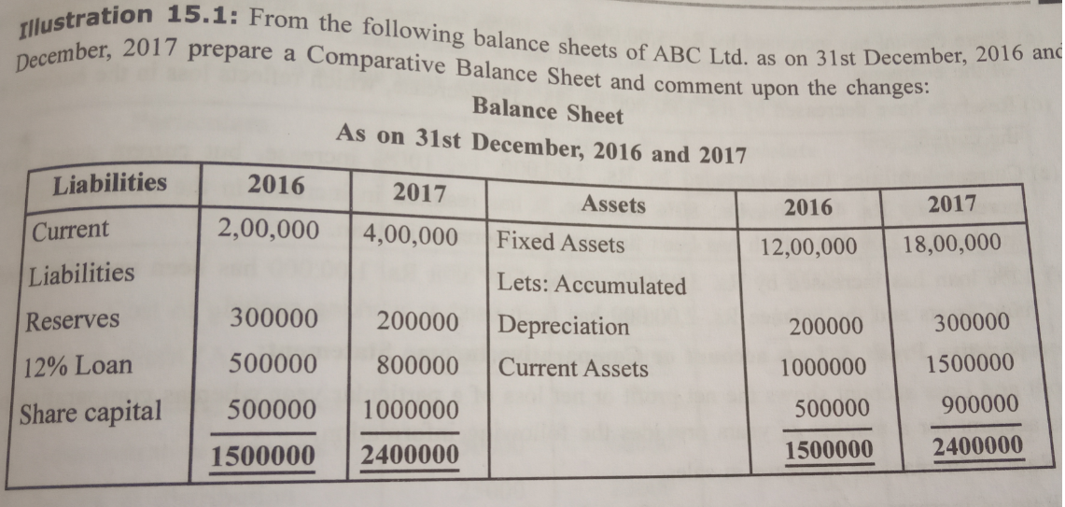

Slide 29
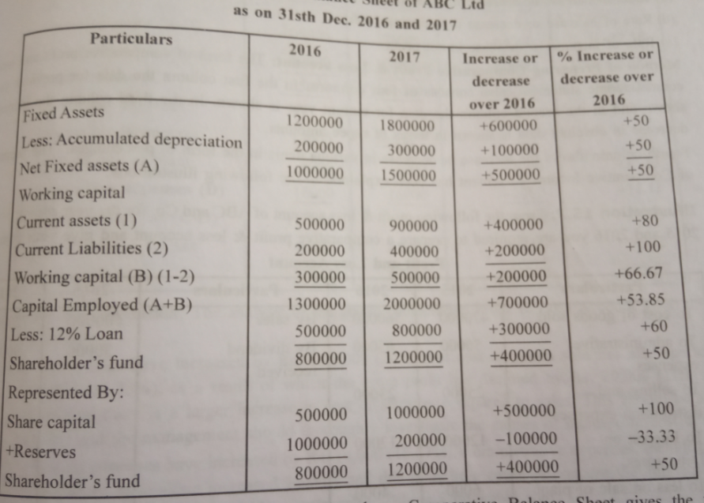

Slide 30
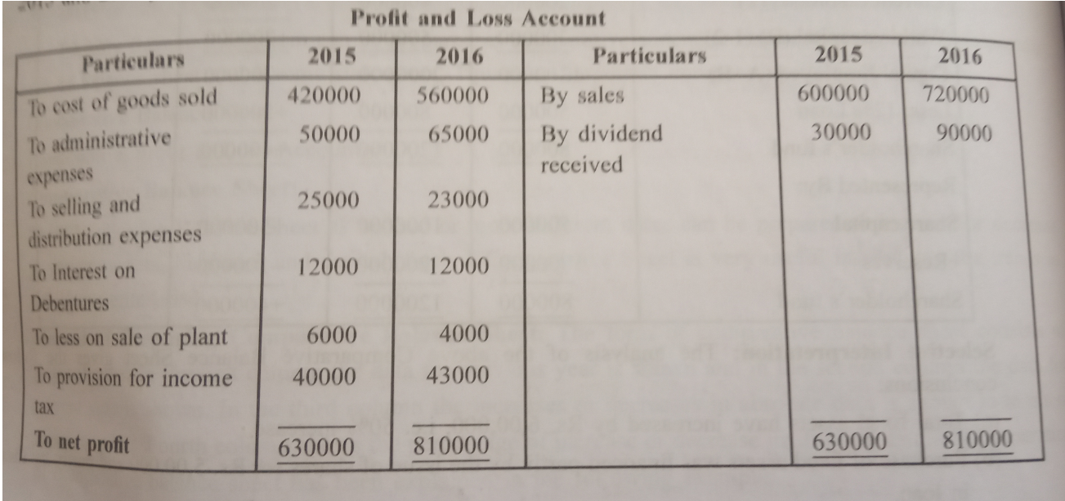

Slide 31
